Slide 1
Networking inside of Kubernetes
Team: Alexander Trinh, Fuyao Wang, Zhe Deng,
Geng Song, Zhou Shen
Mentors: Anish Gupta, Bowen Song

Slide 2
Review
vs
Gossip
RAFT
Notes:
Review how propagates
Gossip -> peer to peer
RAFT -> single leader
Also mention that because RAFT is a single leader architecture, leader elections take place

Slide 3
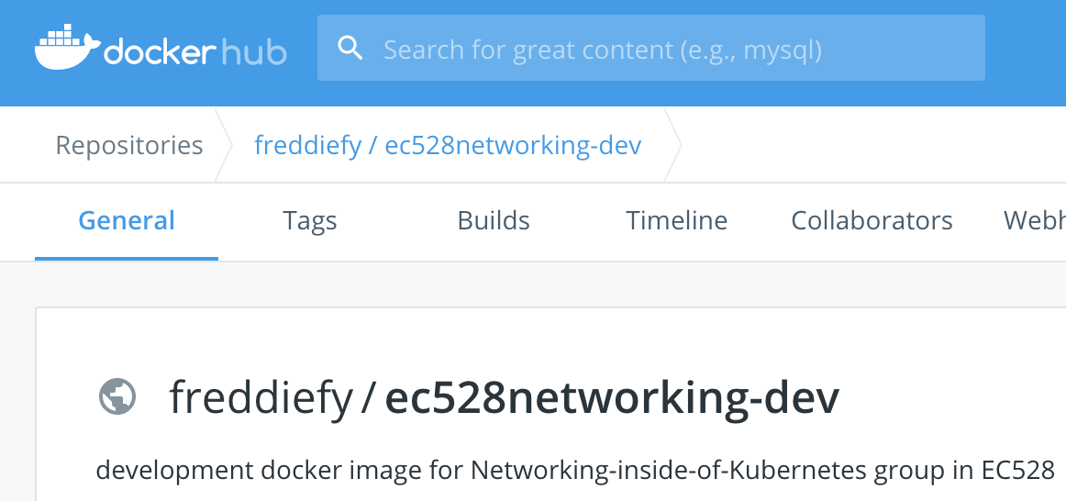
For group dev
Containerized development
Docker image available on dockerhub

Slide 4
CMake
CMake is a cross-platform free and open-source software for managing the build process of software using a compiler-independent method
CMake supports multiple development environments and compilers on the same project
CMake supports continuous integration (CI) testing.
CMake supports integration of 3rd party libraries into your project.
Notes:
CMake supports multiple development environments and compilers on the same project. CMake is used to control the software compilation process using simple platform and compiler independent configuration files

Slide 5
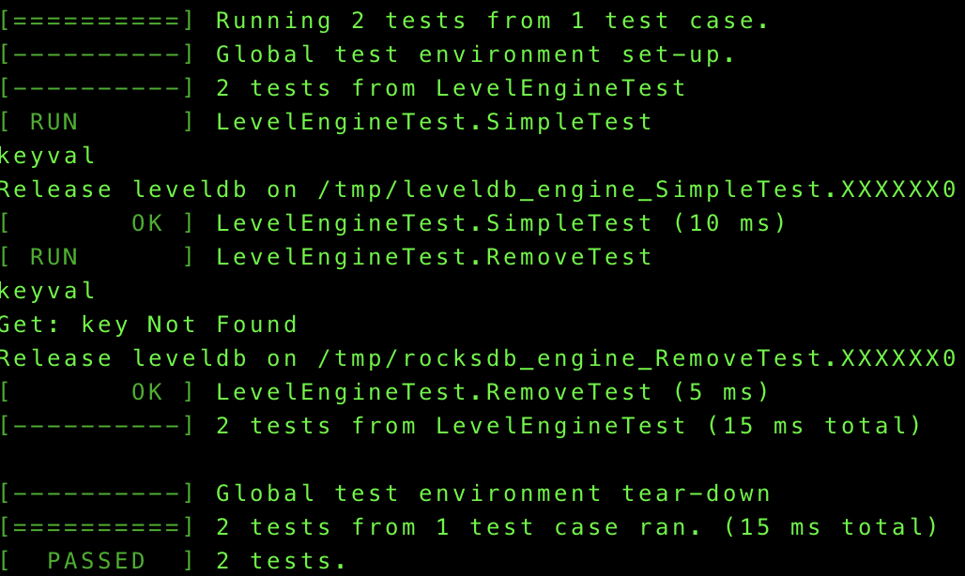
LevelDB
LevelDB is a fast key-value storage library written at Google
Used Googletest to build unit tests and used cmake to build the project

Slide 6
WAL
Write-Ahead Logging (WAL)
Store all needed information in log.
Advantages
Help when system crashes
Help with concurrent writes
Notes:
Concurrent writes - lead to next slide

Slide 7

New Key-Val Log
Planed on implementing two databases for each node initially
Data (in database)
Actual node information
Logging (outside database)
Metadata
Key: LogID
Value: Value from client; Timestamp of action
Notes:
Two databases: node and log
Only 1 database. We store log in txt file outside database.
(Action) in next demo.

Slide 8
Nodes
Implementing in C++ with LevelDB and CPISync
Each node consists of:
A database
A log
A name
Neighbors list
Node States:
Connecting (CPISync server)
Listening (CPISync client)
Main task is to sync logs with CPISync
Notes:
Log syncing:
Uses set reconciliation to sync log differences
Log conflict resolved locally (‘latest’ modification wins)
CPISync goes both ways (ie given a connecting node and a listening node, both with one or more elements that the other does no have, both are ‘synced’)
Remember slide 1’s gif of the Gossip Protocol? The arrows actually go both ways. This is due to how CPISync works
Might be some redundancy
Most important is that any updated modifications in connecting node starts propagating immediately

Slide 9
DEMO - Using CPISync with LevelDB
Notes:
All three nodes have log entries a b and c.
Node 1 adds entries e and f locally after receiving a write request
Node 2 contains d locally
Node 3 contains g locally
After syncing, node 1’s entries (e and f) propagate to nodes 2 and 3
In this demo nodes 2 and 3 also sync their data, but this may not always be the case
The important thing is that Node 1 receives a write, performs the write locally, and then this write propagates.

Slide 10
Issues
Garbage Collection
When to delete old logs
How to deal with difference in time for each node
Means of Reconciliation
Using a key-value database vs a simple json file
Notes:
We don’t want to have a huge log that just keeps growing, we want to trim it down when possible
For this, we plan to implement a timing system so the logs are pruned after a certain amount of time
However then we would have to deal with possible time differences between nodes and inconsistency
Another issue we have is deciding on what to use to store our logs
Using a key-value store like LevelDB or using a simple json file

Slide 11
What We Learned
Incorporating Docker for development
Approach on implementing WAL
How to use LevelDB
CMake
Google Test for unit tests
Resolved CPISync misconceptions
Notes:
Learned how to utilize docker to standardize our testing environment and help everyone test their code
Learned about how write ahead logs work and how we can incorporate it into our project
Learned how to use leveldb as our data store
CMake for compiling our project
We learned about Google tests to create a unit test for every part of code to insure the correctness of code
We were also able to resolve misconceptions about how we were using CPISync as a team
For example how reconciliation between our nodes should work

Slide 12
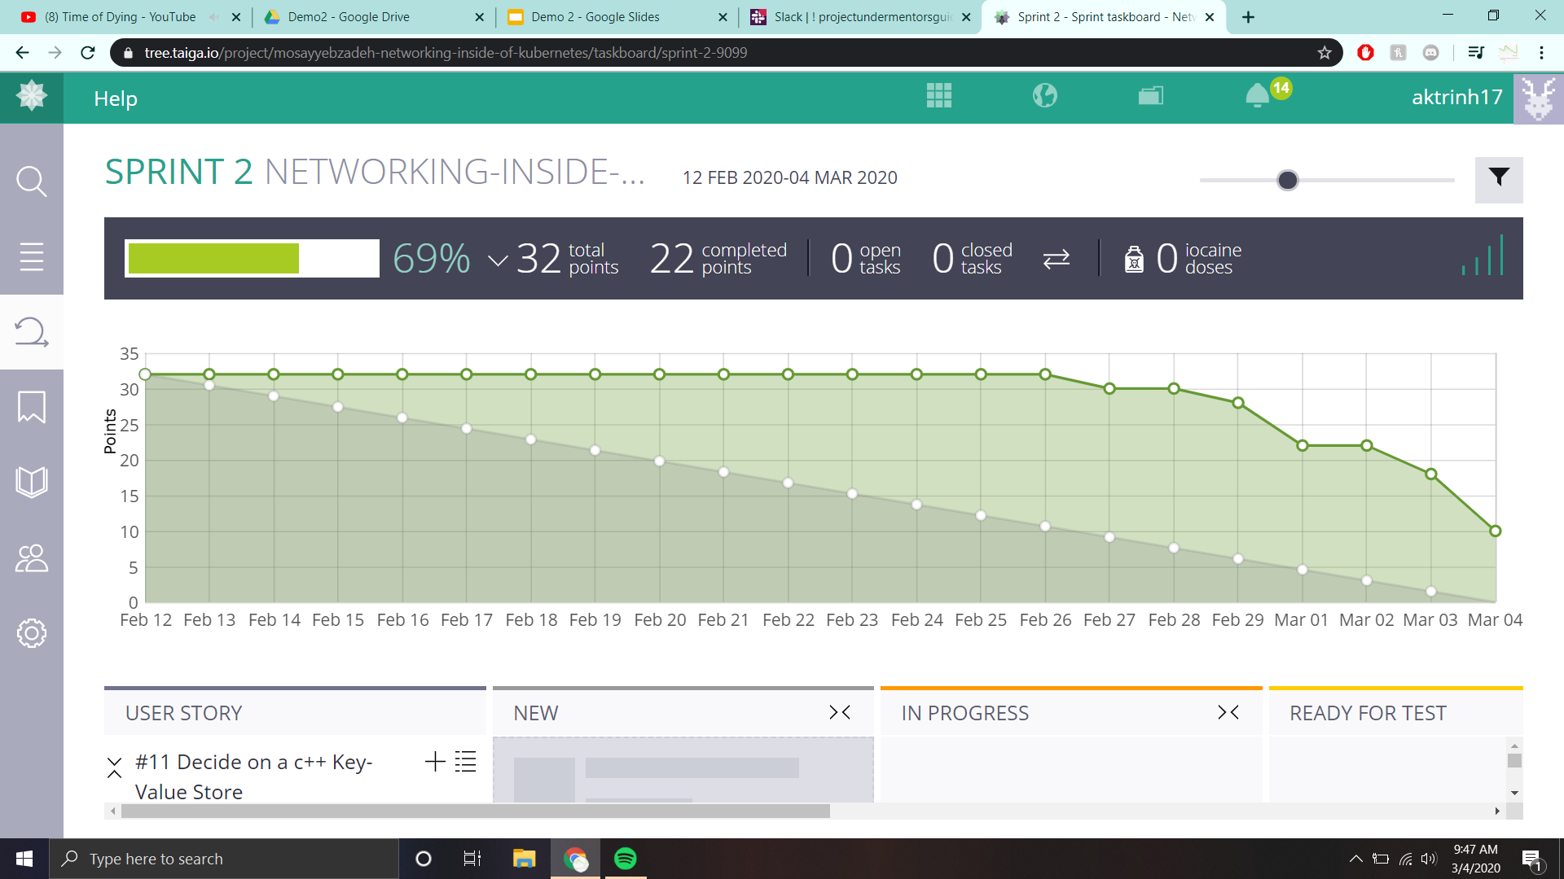
Notes:
Mention what’s going on line
Issues
What we learned

Slide 13
Next Steps
Generalize our Nodes to include neighbor lists and logs
Decide on where to store our logging information
Figure out garbage collection for our logs
Address dealing with adding new nodes into a cluster

